Slide 1

Electronic eye controlled
security system

Slide 2
NEED?
Security is a big challenge everywhere because thefts are increasing day by day owing to the unsafe and insecure security systems in homes, commercial complexes and industries. Several conventional technologies are available to keep home properties safe from intruders

Slide 3

COMPONENTS

Slide 4
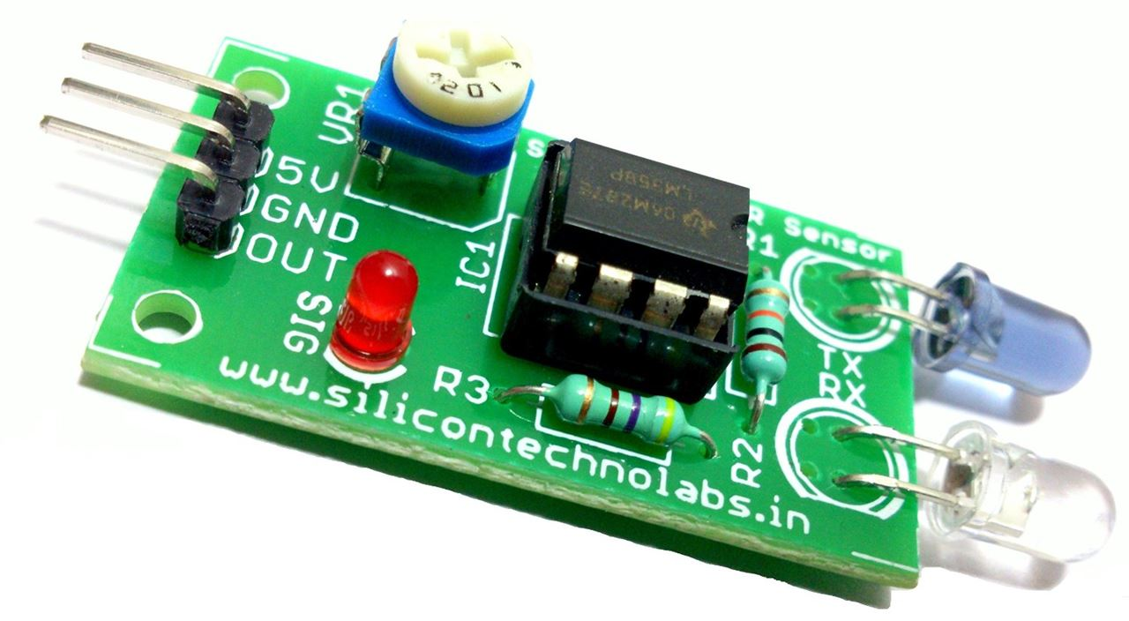
IR Sensor
An infrared sensor is an electronic device, that emits in order to sense some aspects of the surroundings. An IR sensor can measure the heat of an object as well as detects the motion.These types of sensors measures only infrared radiation, rather than emitting it that is called as a passive IR sensor.

Slide 5
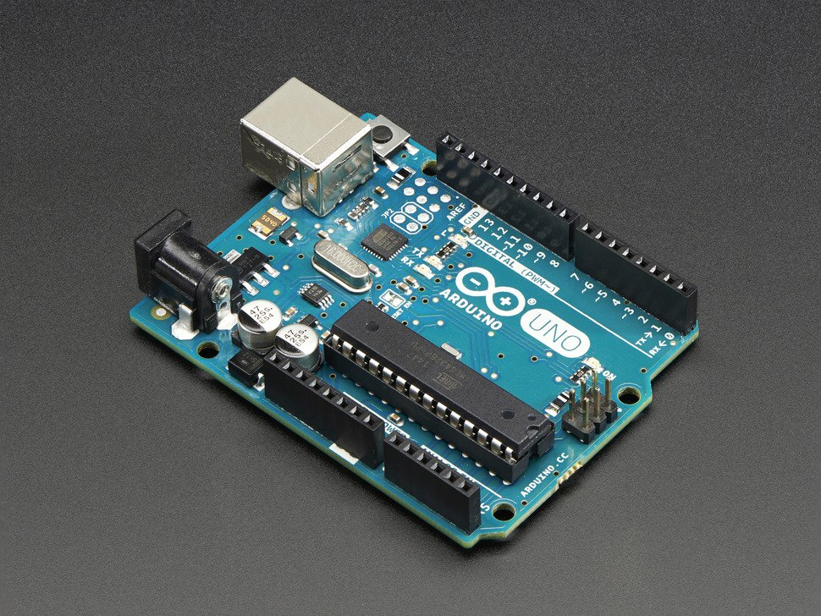
ARDUINO UNO
Arduino uno is an open source electronic platform based on easy to use hardware and software. It’s intended for anyone making interactive projects.

Slide 6
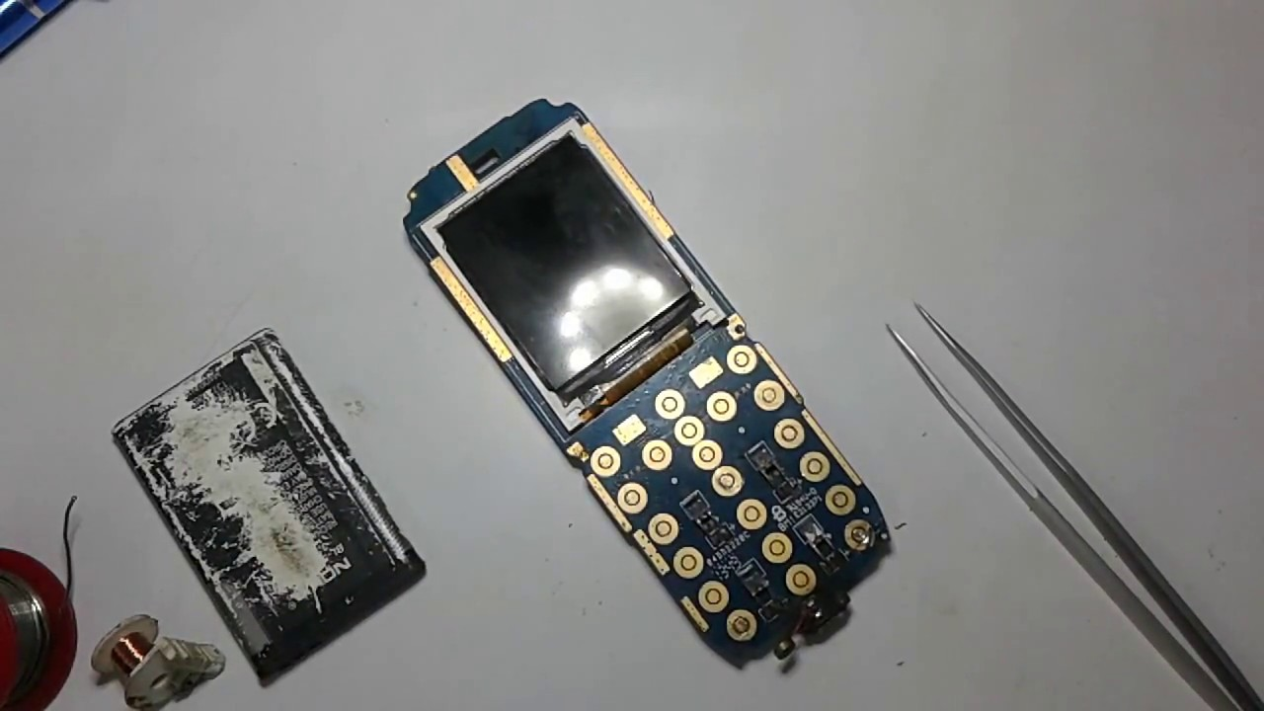
MOBILE
As an alternative of GSM module
GSM modem allows the device to communicate over the mobile network through calls, SMS and MMS messages . It consists of a SIM card and operates over a subscription through a mobile network. It is a highly flexible plug-and-play device capable of connecting to a PC or any microcontroller .

Slide 7
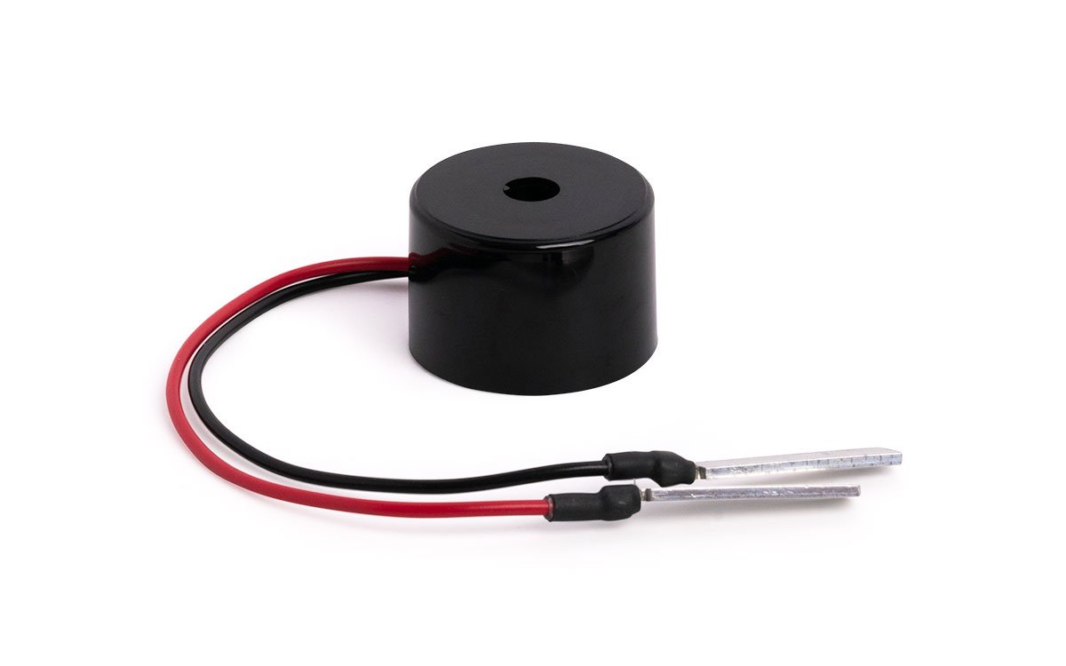
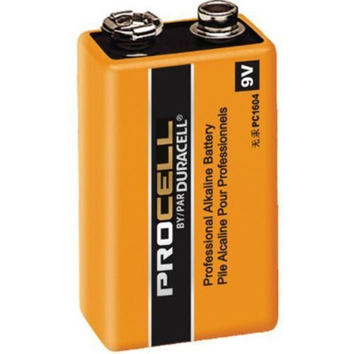
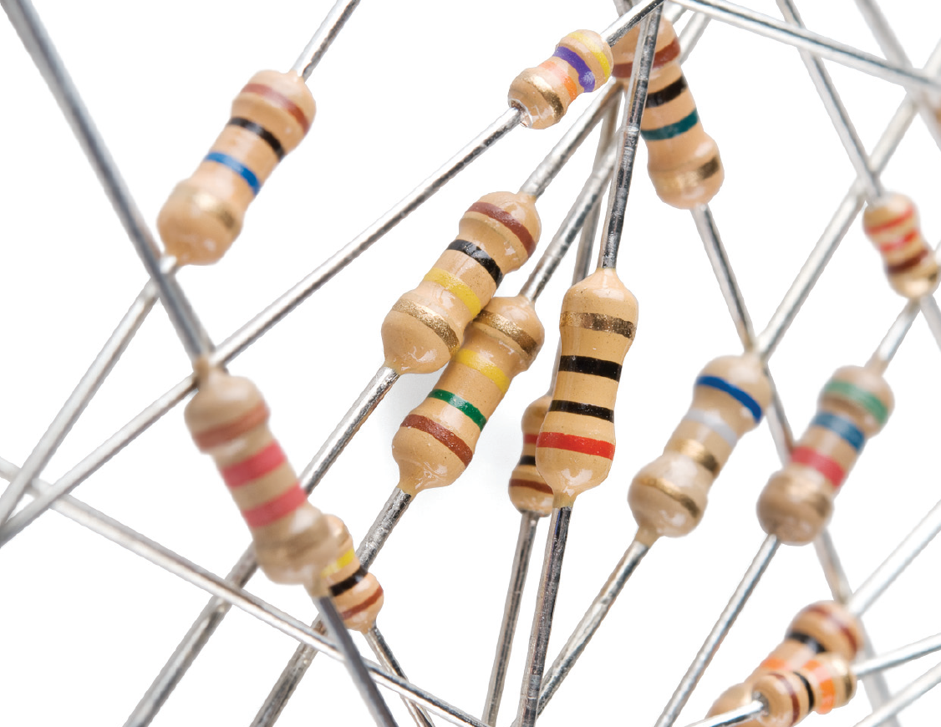
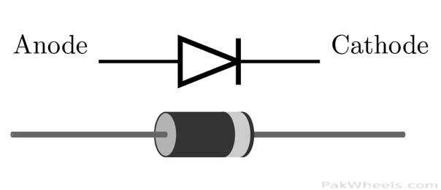
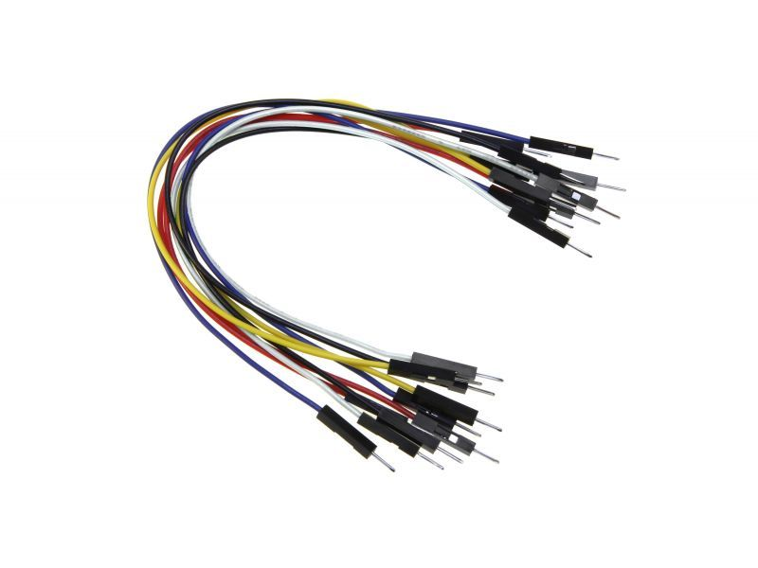
BUZZER
RESISTOR
BATTERY
JUMPER WIRES
DIODE

Slide 8

Circuit Diagram

Slide 9
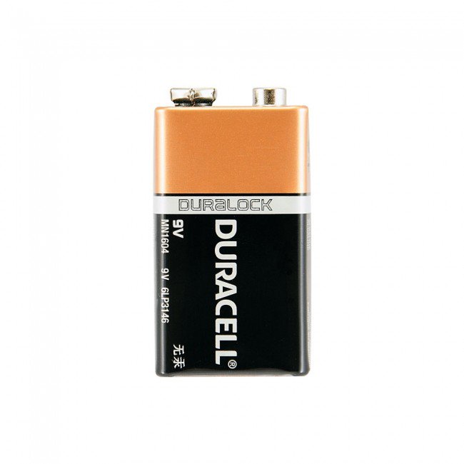
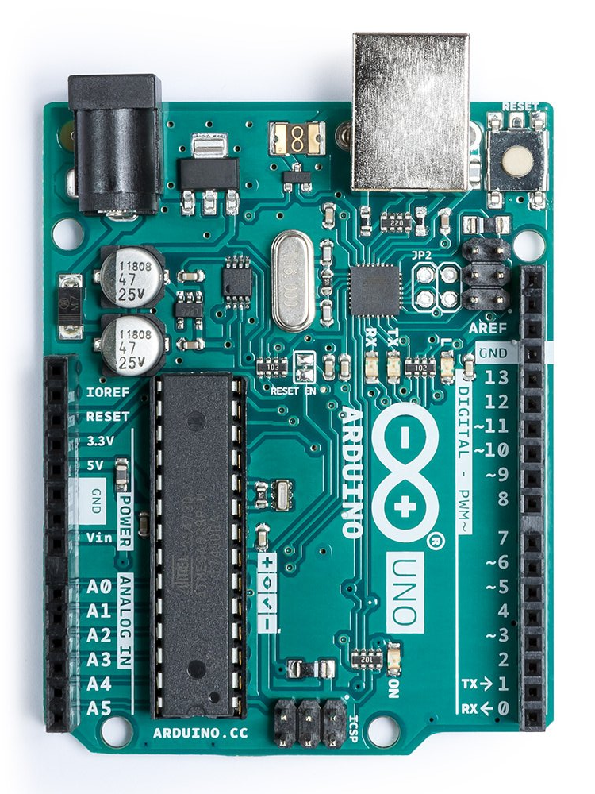
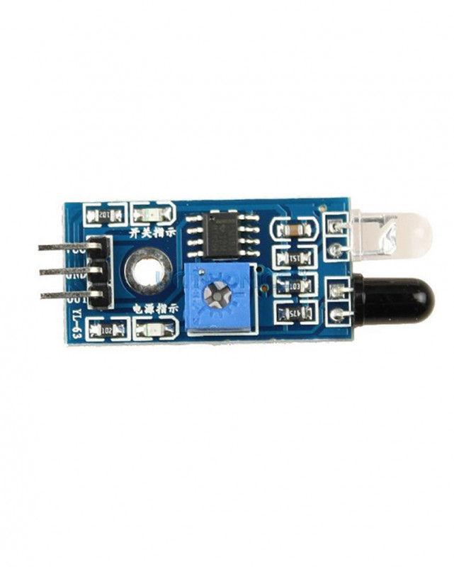
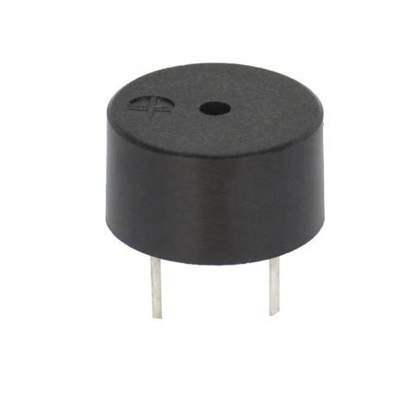

Slide 10
M
O
B
I
L
E
ARDUINO
VCC
IR Sensor
OUTPUT
GND
Call on another mobile
BATTERY
BATTERY

Slide 11
WORKING
Input will be taken by Infra-Red sensor. Arduino will receive input from IR.
Arduino will process the input as per the designed program .
As per the received output from the Arduino , mobile will give message to the connected device (owner) .

Slide 12

Applications

Slide 13
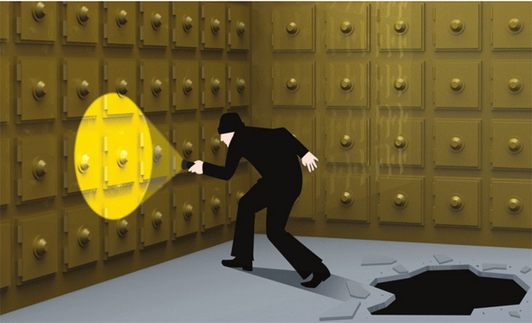
BANK LOCKER SECURITY

Slide 14
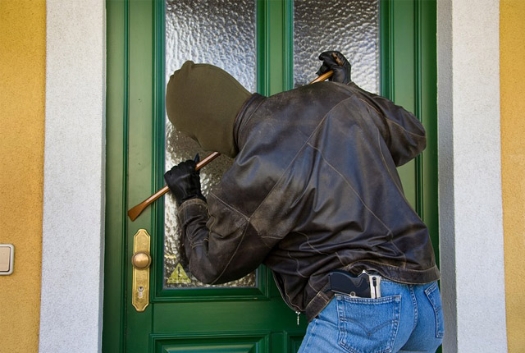
HOME SECURITY

Slide 15
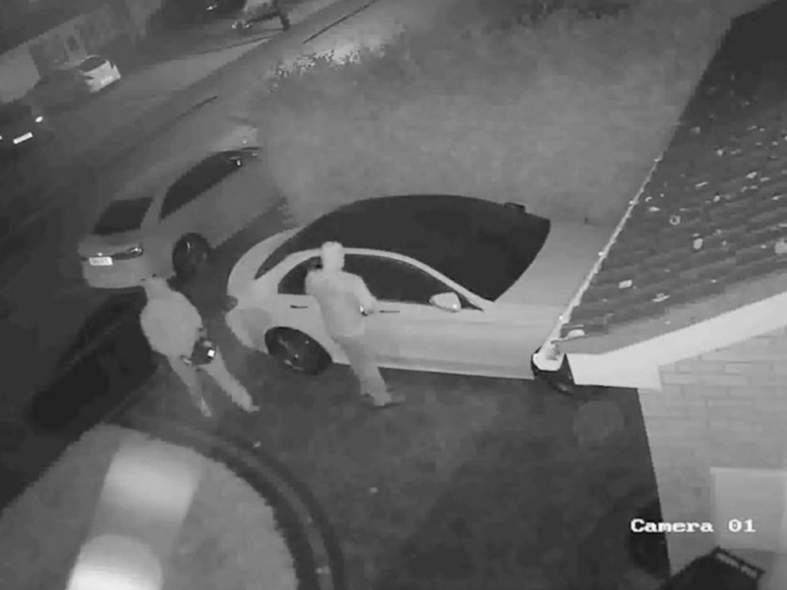
AUTOMOBILES SECURITY

Slide 16
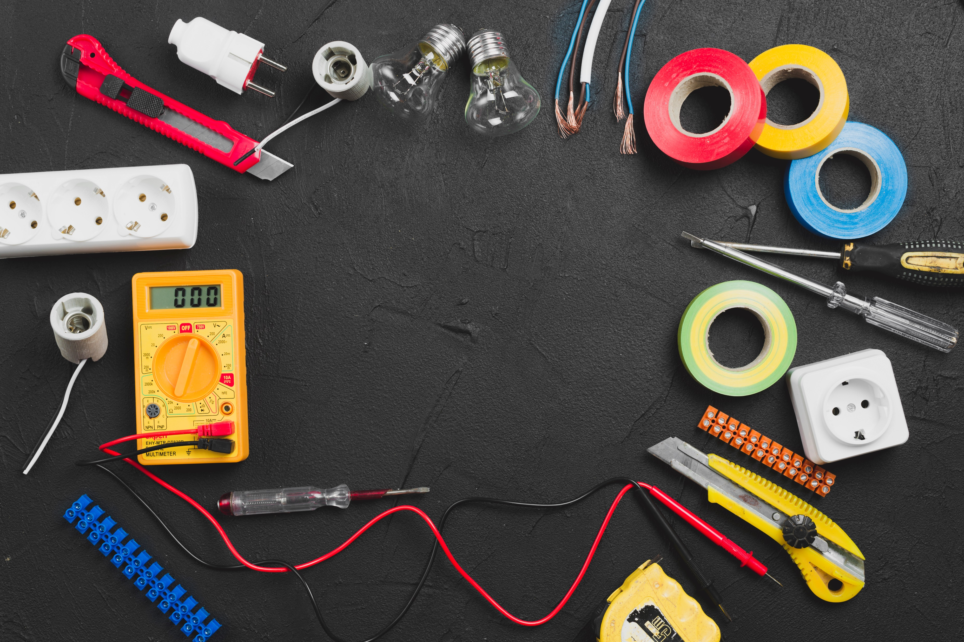
THANKS

